Slide 1
EDA – CREDIT ASSIGNMENT
NAME : PRATEEK JAIN
BATCH ID: 1975
Data Science Program - March 2022

Slide 2
INTRODUCTION
Given dataset of loan providing company
3 .csv files as dataset
1. Application
2. Previous Application
3. Column description

Slide 3
About Dataset
Application
Contain information at the time of applying
The client with payment difficulties:
Previous Application
Contain information about four types of decisions that could be taken
Approved
Column Description
Contains information
Description/meaning of the columns so as to get better understanding of dataset
All other cases:
Cancelled
Refused
Unused offer

Slide 4
Business Understanding
The loan providing companies find it hard to give loans to the people due to their insufficient or non-existent credit history
When the company receives a loan application, the company has to decide for loan approval based on the applicant’s profile

Slide 5
Objective
Understanding
How consumer attributes and loan attributes influence the tendency of default.
Identifying
Patterns indicating if a client has difficulty paying their installments
Predicting
Consumers capable of repaying the loan are not rejected.
Understand the driving factors (or driver variables) behind loan default
Top 10 correlations

Slide 6
APPLICATION DATAFRAME
1.
Importing Libraries
2.
3.
Dropping columns with missing values >45%
4.
5
Continuous column - Columns containing unique values > 58
9
6
7
Imputation for missing value<45 (categorical – mode, continuous – median)
8
Dropping unnecessary columns
Reading the data set and finding percentage of null values
Identifying continuous and categorical columns/variable
Categorical column – Columns containing unique values < 58
Detecting Outliers – Using Subplots
10
Handling outliers by flooring and capping

Slide 7
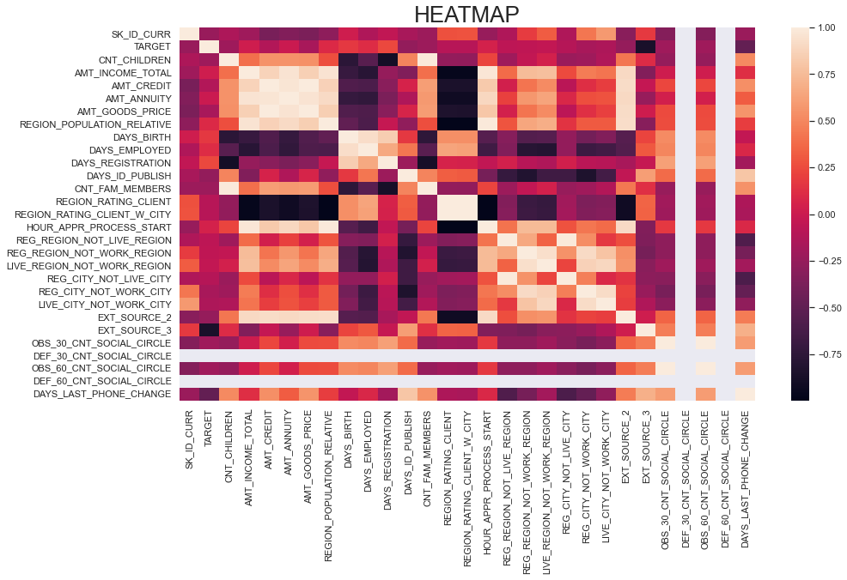

Slide 8
UNIVARIATE ANALYSIS

Slide 9
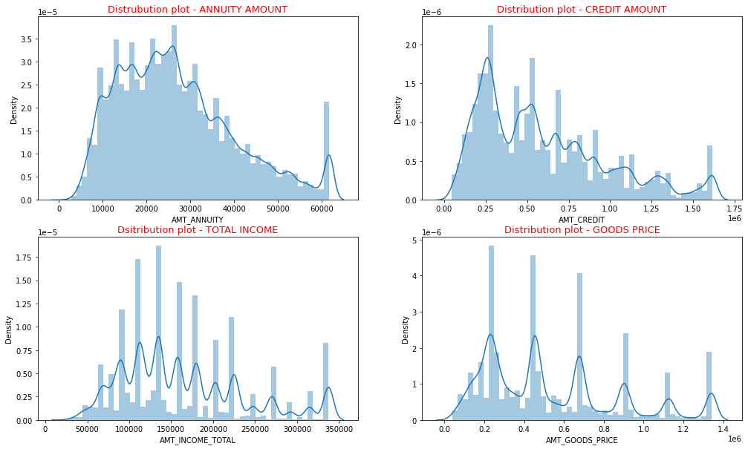
SUBPLOTS
Most of the people taking loans have annuity between 20000 and 30000

Slide 10
DEFAULTER AND NON DEFAULTERS
APPLICATION LOAN DATASET – TWO MAIN VARIABLES
DEFAULTER
NON DEFAULTER
DEFAULTERS
The client with payment difficulties
Response is stored as 1 (‘Y’- Yes)
NON DEFAULTERS
All other cases
Response is stored as 0 (‘N’- No)

Slide 11
Large number of people applying for loans are non defaulters
BARPLOT – DEFAULTER AND NON DEFAULTERS

Slide 12
Making two Dataframes
1. Defaulters (TARGET = 0)
2. Non- Defaulters (TARGET = 1)
Univariate analysis for each Dataframes using subplots

Slide 13
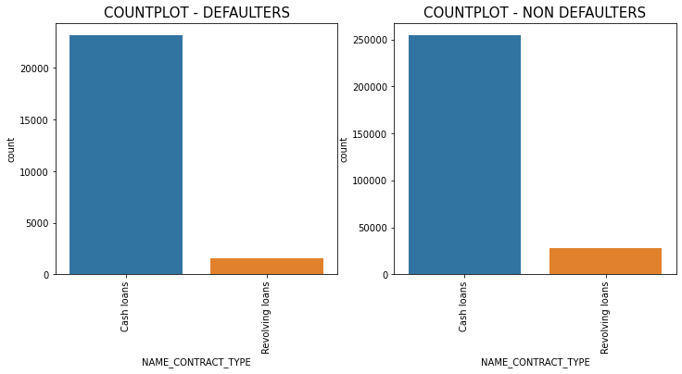
COUNTPLOT – LOAN TYPE
Number of people whether defaulters or non defaulters prefer to take ‘CASH LOAN’ as compared to ‘REVOLVING LOAN’

Slide 14
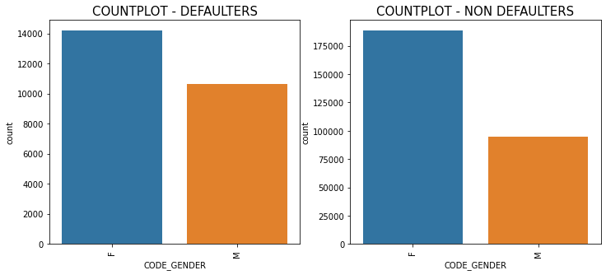
COUNTPLOT - GENDER
Number of "FEMALE" taking loans is much higher than the number of "MALE" for both the target variables

Slide 15
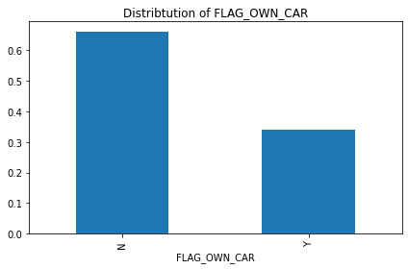
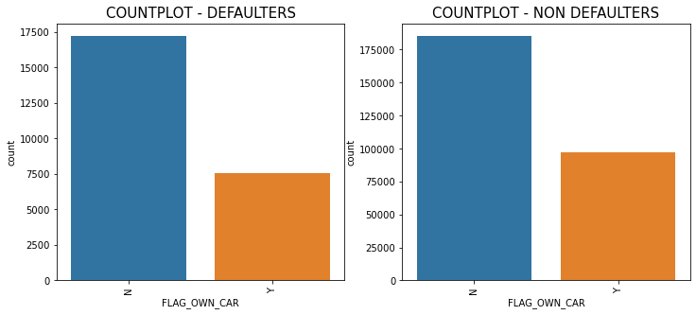
COUNTPLOT - CAR
People who “DON’T OWN CAR” are applying more for loan
Most people applying for the loan and have car are "NON DEFUALTER"

Slide 16
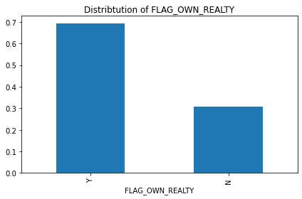
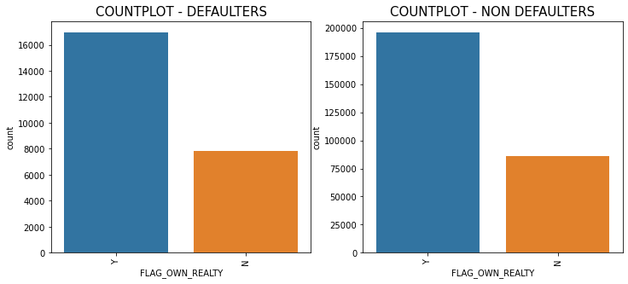
COUNTPLOT - HOUSE
Most people applying for the loan have own house
People having 'OWN HOUSE' and non defaulters are more

Slide 17
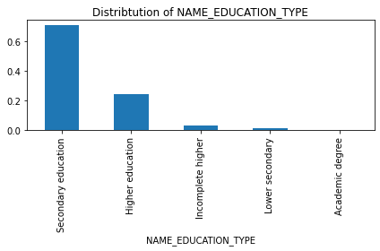
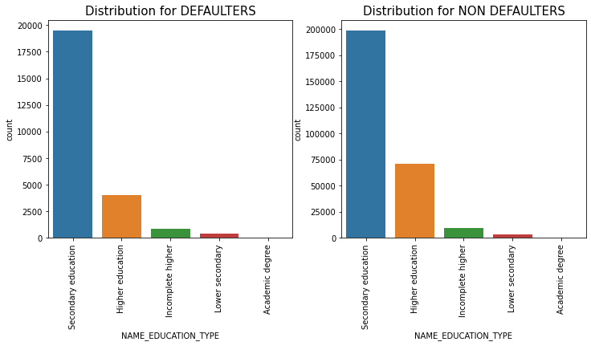
People applying for the loan, mostly have secondary education
People having secondary & higher education have less payment difficulties
People have academic degrees can also be targeted as they apply less for the loans

Slide 18
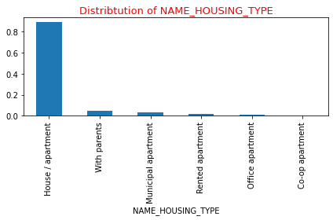
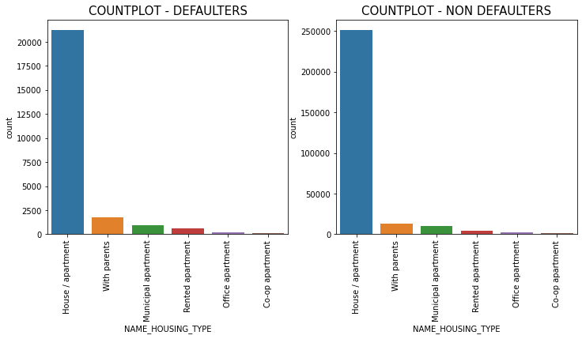
People applying for the loan are mostly living in a house/apartment
Large number of people applying for loans have there own 'HOUSE/APARTMENT'
People living 'WITH
PARENTS' are more likely to have payment difficulties.

Slide 19
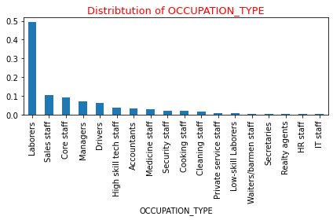
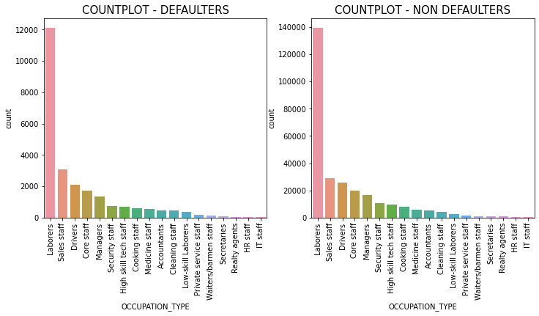
Labourers are applying more for loan as compared to other category
Labourers are the maximum number of defaulters and non defaulters

Slide 20
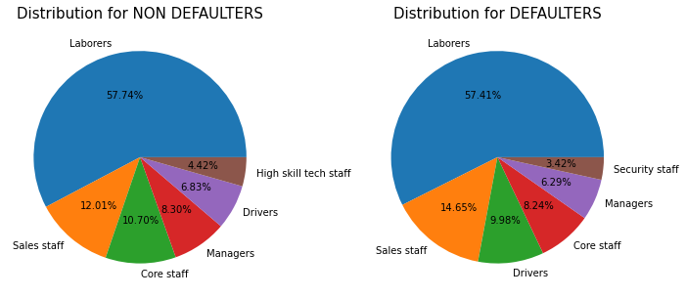
From the previous graph we took only 5-6 categories so as to more insight

Slide 21
INFERENCES FROM PREIVOIUS SLIDE accept the applications of Non Defaulter where % is higher.
Core Staff - 5.34% higher than defaulters
Managers - 1.94% higher than defaulters
High skill tech staff - Not listed in Defaulters list as we have taken only 6 maximum values

Slide 22
BIVARIATE & MULTIVARIATE
ANALYSIS
Now we will find out the defaulters
We will work upon the separate dataset for deaulters (TARGET = 1)
We will try to plot relationships between different variables toget more insight

Slide 23
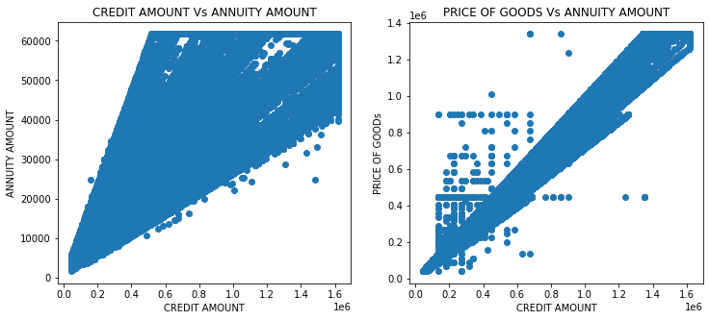
SCATTER SUBPLOTPLOT – CREDIT Vs ANNUITY AMOUNT, CREDIT Vs PRICE OF GOODS
Positive correlation between ANNUITY & CREDIT AMOUNT
Positive correlation between PRICE OF GOODS & CREDIT AMOUNT

Slide 24
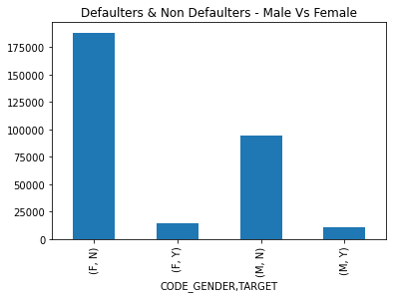
Number of female defaulter and non defaulter are more than males

Slide 25
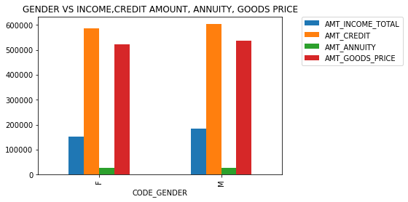
Income of male is pretty higher than of female so we can say that males have less loan payment difficulty.
Males can get loan easily as compared to female.

Slide 26
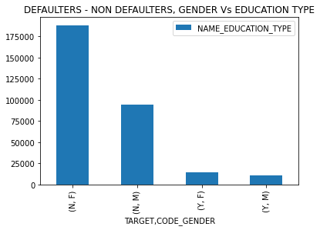
Most of the Non defaulter women are educated as compared to males.

Slide 27
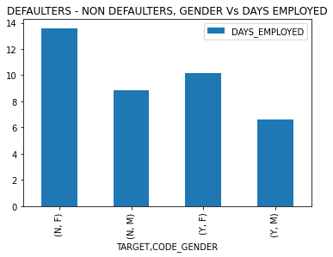
Females employed days are higher than males

Slide 28
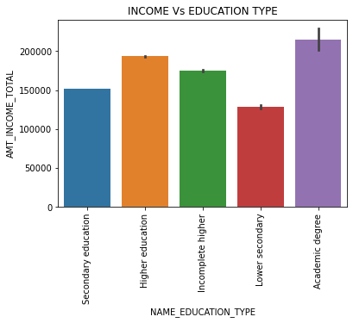
People having academic degree have high median salary. So people with Academic Degree can be targeted

Slide 29
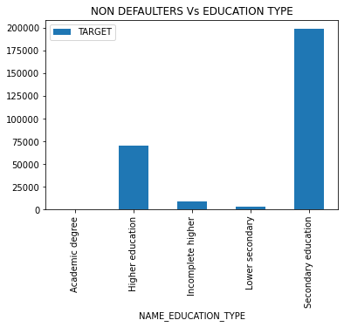
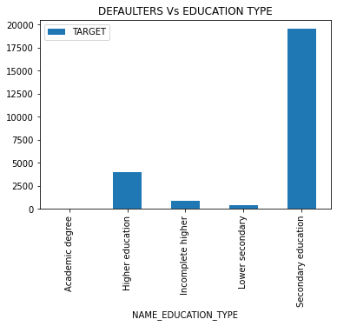
DEFAULTER – NON DEFAULTERS VS EDUCATION TYPE
People having secondary education are highest number of defaulter and non defaulters
People having Higher education are more in non defaulter bucket so they can be targeted

Slide 30
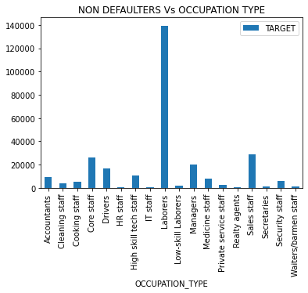
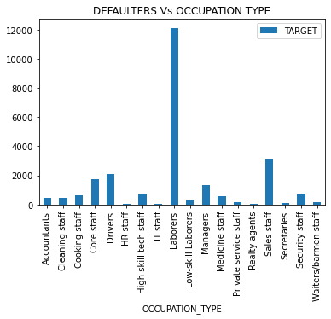
Maximum number of Labourers are the defaulters and non defaulters both

Slide 31
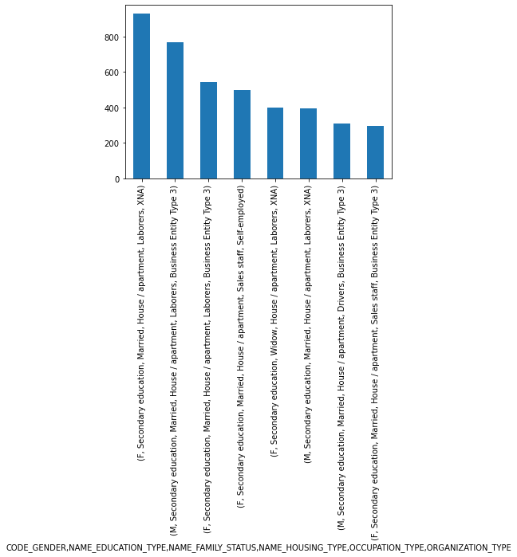

Slide 32
INSIGHT
MAJOR DEFAULTERS
WORKING IN A BUSINESS ENTITY TYPE 3
MALE & FEMALE
MARRIED
LIVING IN APARTMENT

Slide 33
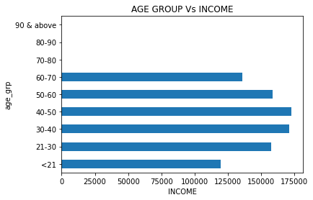
Maximum number of the people applying for the loan are between 40-50 age and have high mean salary

Slide 34
PREVIOUS APPLICATION DATASET Data cleaning approach is same as in application dataset
1.
Importing Libraries
2.
3.
Dropping columns with missing values >45%
4.
5
Continuous column - Columns containing unique values > 58
9
6
7
Imputation for missing value<45 (categorical – mode, continuous – median)
8
Dropping unnecessary columns
Reading the data set and finding percentage of null values
Identifying continuous and categorical columns/variable
Categorical column – Columns containing unique values < 58
Detecting Outliers – Using Subplots
10
Handling outliers by flooring and capping

Slide 35
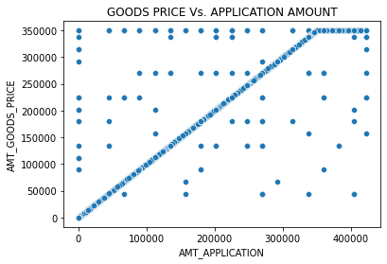
As the goods price increases amount of loan application also increases

Slide 36
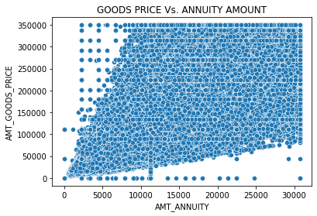
As the goods price increases annuity amount also increases

Slide 37
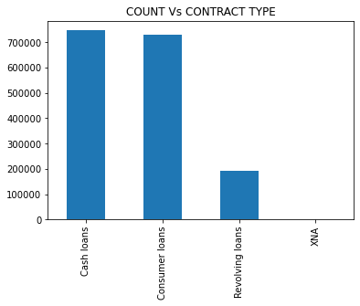
People previously applied for cash loans more

Slide 38
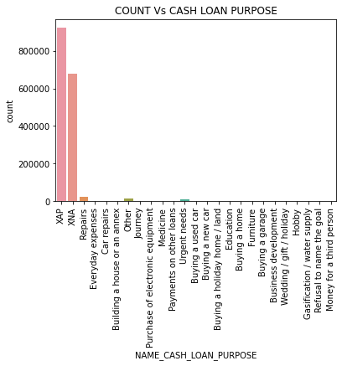
IGNORING XAP, XNA. GOING DEEPER FOR OTHER CASH LOAN PURPOSE

Slide 39
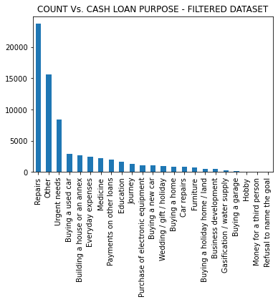
Maximum number of people are applied for loan for repair purpose
Secondly people applies, for other reasons
People also require loan for urgent needs which are not specified
People applies loan for buying a used car, building a house.

Slide 40
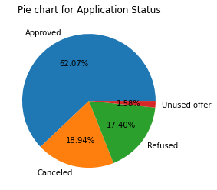

Slide 41
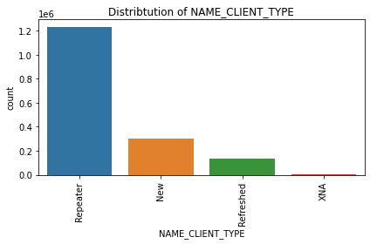
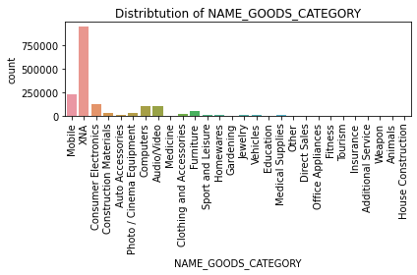
Maximum number of old clients are applying for the loan again
Other than XNA, people are applying loan for mostly mobile phones.

Slide 42
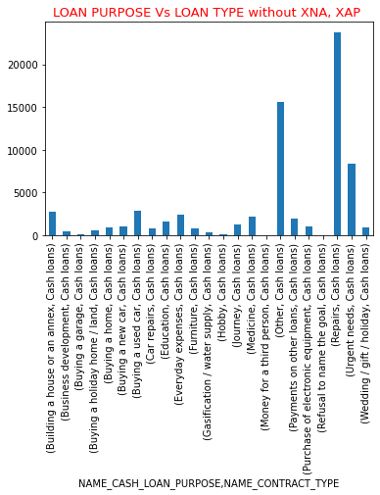
Maximum number of people are taking cash loans for Repair

Slide 43
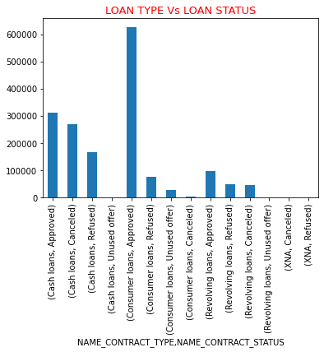
Maximum number of loans that are approved is Consumer loans
Cancellation of Consumer loans is very less as compared to cash and revolving loans

Slide 44
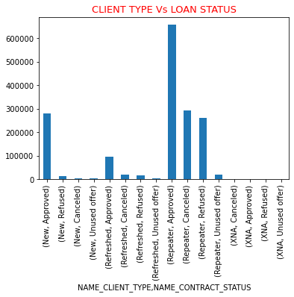
Company approves the loan for maximum number of people who are applying for the new loan again
For People applying for the first time, company tries not to cancel the loan application that is why cancellation for new people is very less as compared to refreshed and repeaters

Slide 45
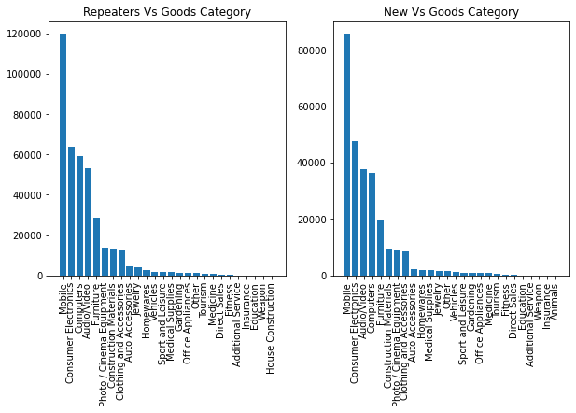
Maximum number of people ( Repeaters and New ) are applying loan for mobile phones.

Slide 46
Merging two data sets
Application & Previous Application
Drawing Inferences

Slide 47
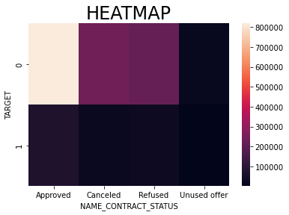
Maximum number of loan is approved for non defaulters
Loans are approved for defaulters also.
Loans are refused for non defaulters also.

Slide 48
MAJOR – INSIGHT By taking mode of categorical columns with Target = 0, CONTRACT_STATUS = Refused By taking mode of categorical columns with Target = 1, CONTRACT_STATUS = Approved
LOAN REFUSED PREVOUSLY FOR DEFAULTERS
LOAN APPROVED PREVIOUSLY FOR NON DEFAULTERS
LABOUR BY OCCUPATION AND WORKING IN BUSINESS ENTITY 3
APPLYING FOR CASH LOANS
FEMALE, MARRIED, HAVE SECONDARY EDUCATION
DOESNOT OWNS CAR, BUT HAVE HOUSE

Slide 49
THANK YOU

